Slide 1

AI training group
Weekly Report
Nguyen khai phu – OCT 13 2023

Slide 2
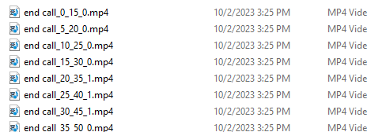
Data
ISP008 foundation
Duration: 16 frames
Stride: 5 frames
Total: 6318
Positive: 601
Negative: 5717
2
CISP-1352-A21 - ISP-DOC-STYLETYPE-Templates © Robert Bosch GmbH 2016. All rights reserved, also regarding any disposal, exploitation, reproduction, editing, distribution, as well as in the event of applications for industrial property rights.

Slide 3
Models & Issues
ISP008 foundation
Models (torchvision.models):
Seperable 3D CNN
ResNet3D-18
Multiscale ViT v2
2
CISP-1352-A21 - ISP-DOC-STYLETYPE-Templates © Robert Bosch GmbH 2016. All rights reserved, also regarding any disposal, exploitation, reproduction, editing, distribution, as well as in the event of applications for industrial property rights.

Slide 4
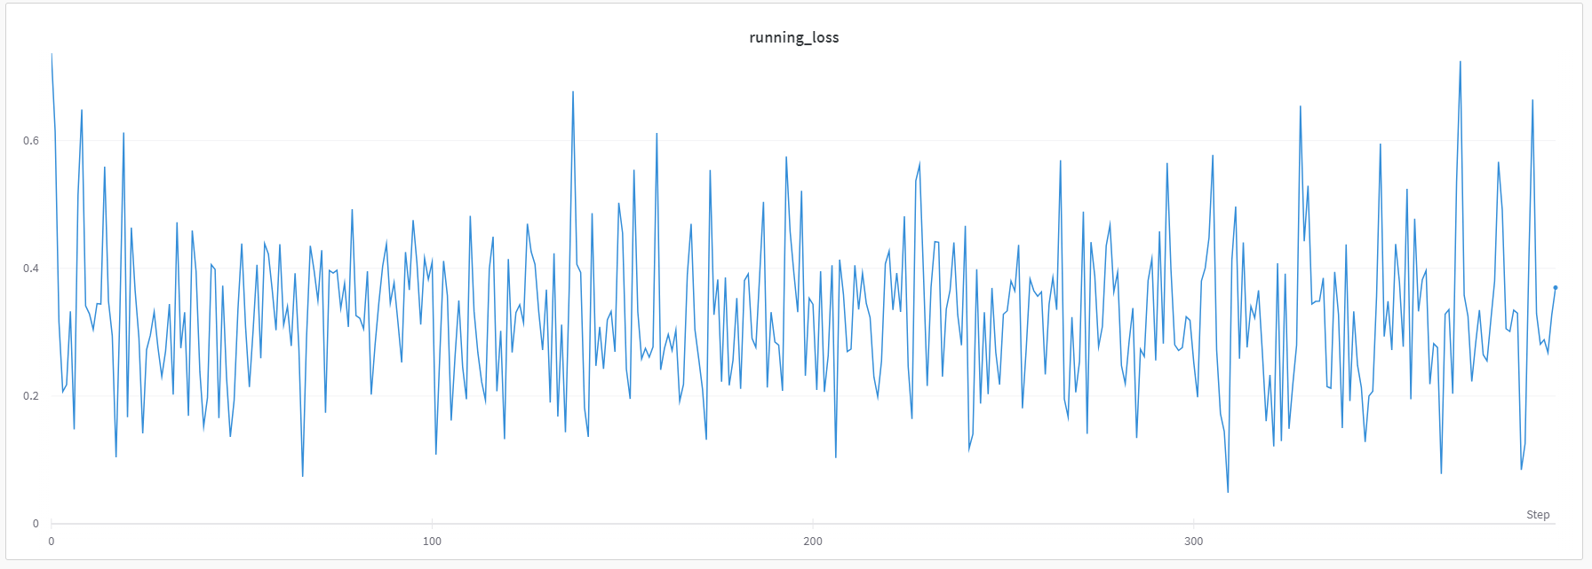
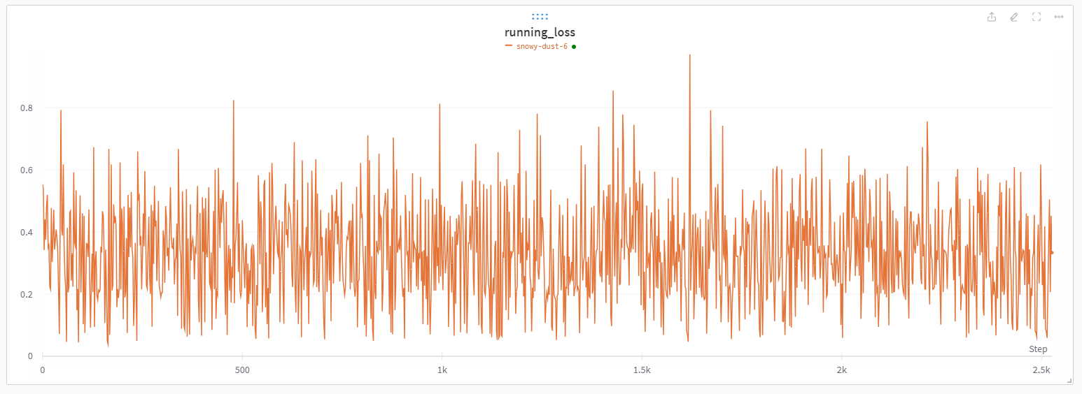
Models & Issues
ISP008 foundation
Models (torchvision.models):
Seperable 3D CNN
ResNet3D-18
Multiscale ViT v2
Issues:
OOM -> Small batch size (<= 4)
Long training time (~1 hour/epoch)
Not converge
2
CISP-1352-A21 - ISP-DOC-STYLETYPE-Templates © Robert Bosch GmbH 2016. All rights reserved, also regarding any disposal, exploitation, reproduction, editing, distribution, as well as in the event of applications for industrial property rights.

Slide 5
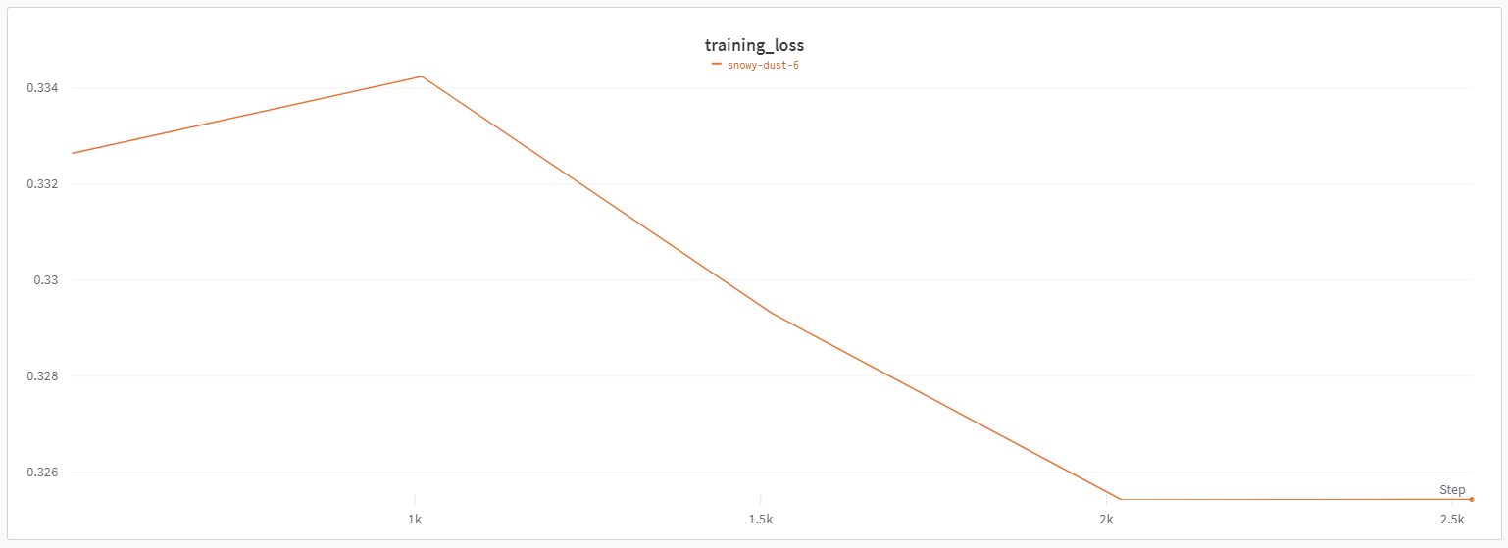
Models & Issues
ISP008 foundation
Models (torchvision.models):
Seperable 3D CNN
ResNet3D-18
Multiscale ViT v2
Issues:
OOM -> Small batch size (<= 4)
Long training time (~1 hour/epoch)
Not converge
2
CISP-1352-A21 - ISP-DOC-STYLETYPE-Templates © Robert Bosch GmbH 2016. All rights reserved, also regarding any disposal, exploitation, reproduction, editing, distribution, as well as in the event of applications for industrial property rights.

